Slide 1
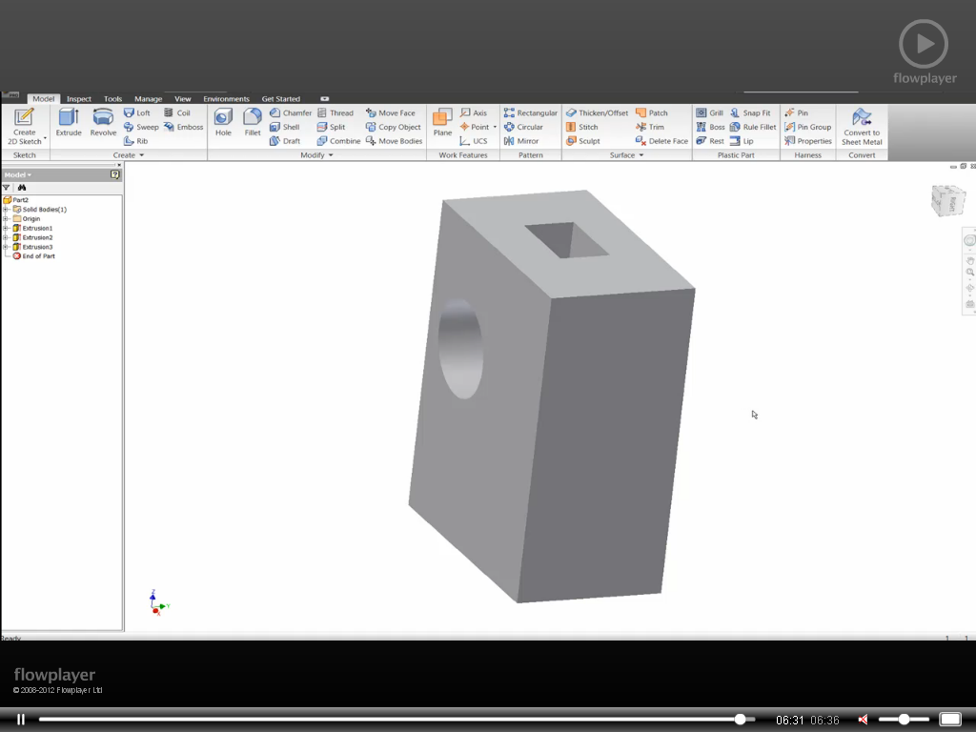
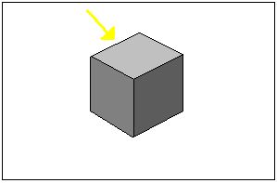
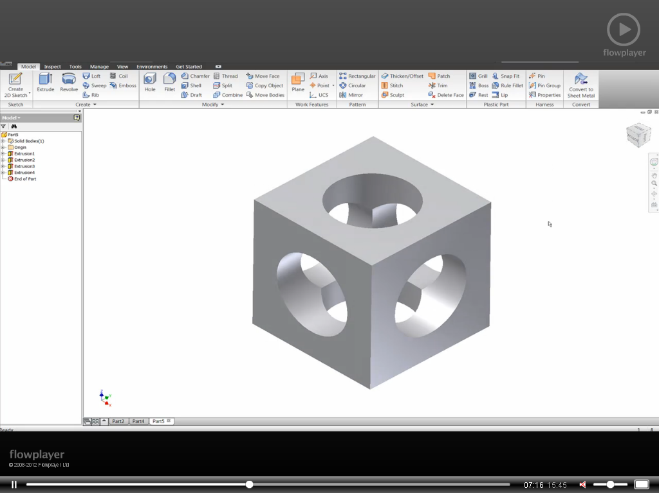
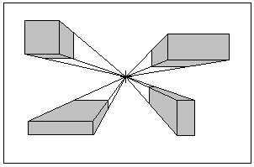
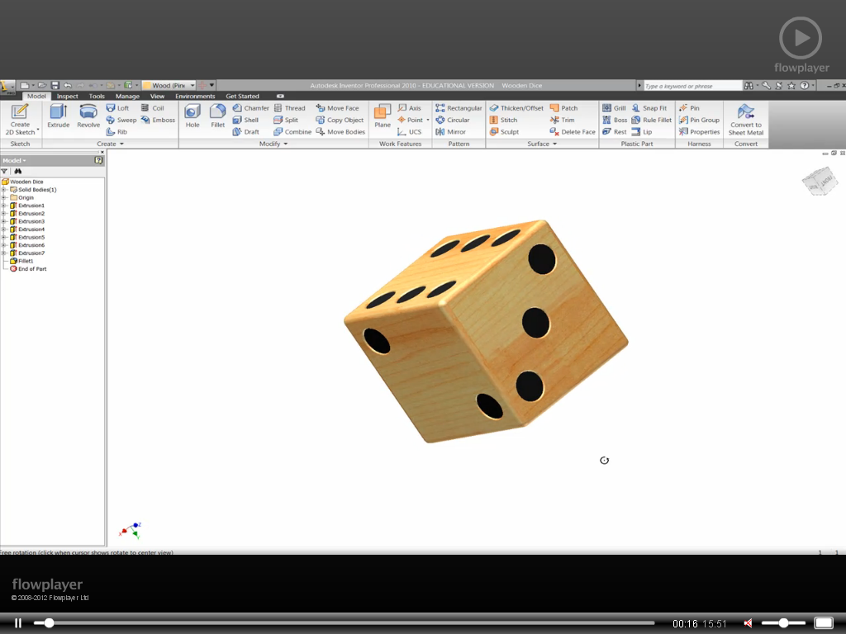
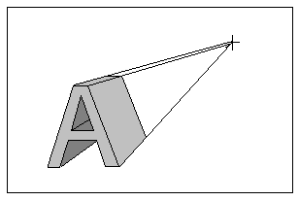
How closely were the plans/design followed?
How closely were the plans/design followed?
Tool skills (marking out…acrylic backplate)
Colour
The model was a true likeness to the plan/design
The model was a true likeness to the plan/design
All the lines were marked out accurately
The model resembled the plan/design
The model resembled the plan/design
Most of the lines were marked accurately
The model was different from the plan/design
The model was different from the plan/design
None of the lines were marked out correctly
Tool skills (file) – Which edges were shaped well?
Tool skills (coping saw) – Which edges were shaped well?
Tool skills (cutting)
Shade the circles green, amber or red to show how well you feel you shaped the edges with the file.
All lines were cut accurately (2mm from pencil line)
All cuts are accurate and neat
Most lines were cut accurately but more care needed
Most of the cuts were in the right place
Candidate went over pencil lines
Cuts were untidy and candidate cut over lines
Was the key fob finished to high standard?
Was the spatula finished to high standard?
Tool skills (drilling) Using the pillar drill
All the edges were smooth with no rough parts
All the edges were smooth with no rough parts
Hole drilled in centre and to correct depth
Most of the edges were smooth
Most of the edges were smooth
Hole drilled near centre and depth is reasonable
The edges were rough and sharp
The edges were rough and sharp
Hole drilled too close to edge and at incorrect depth
Colour
Range of tools used
I can draw a range of primitive shapes in 1-point.
Checklist:
Are your construction lines faint?
Have you clearly lined in your drawing?
Are your drawings accurate?
Checklist:
Are your construction lines faint?
Have you clearly lined in your drawing?
Are your drawings accurate?
Use of colour (suitable background colour used, followed a colour scheme etc.
I Have used a varied range of drawing tools - line, rectangle, circle, spray can etc)?
2
In the circle grade each drawing 1 -5, 1 being the best and 5 the worst.
In the circle grade each drawing 1 -5, 1 being the best and 5 the worst.
Titles
Copy and Paste
Appropriate font used, various text sizes used for headings etc.
I am able to copy and paste graphics from M.S Paint to publisher without issues?
I can add tone and shade to three surfaces correctly depending on the position of the light source.
Drawing 1
Drawing 2
Images and graphics
I can construct a range of complex shapes such as letters in 1-point.
Drawing 2
Drawing 5
Images used are relevant to the product being advertised (snowboards)
Overall presentation
Opening and saving documents
Drawing 3
Drawing 7
Suitable layout (not too cluttered), clear and easy to read.
I can open the blank template file and then save a copy in their personal folder
Drawing 4
Drawing 10
Working with others in group tasks
Constructing paper models
TEACHER FEEDBACK
PUPIL ACTION PLAN
Use this space to record any feedback from your teacher.
Use this space to state how you intend to make improvements to your work.
I took a passive role in the group work
I helped to make basic shapes/forms
In paper/card
TASK
NEXT STEPS
I took an active role within the group and I was involved in helping find solutions.
I helped to make more complicated parts of the model out of paper/card
TASK
NEXT STEPS
I helped to lead the group and encouraged others to participate
I made decisions and was able to effectively create load bearing structures
TASK
STEPS

